Slide 1

Data Science Mini Project Problem C - Use of Retail Banking Transactional Data Problem Owner:Lloyds Banking Group
Group 25
Bohan Liu, Haolong Li, Shuyao Yi

Slide 2




Background
Motivation
Annual Analysis
User Profiling
Data Source
Feature
Ethics
Purchase Trend
Time Persepective Service Design
Annual Analysis
User Profiling
Customer Types
New Feature
DIY Service Design
2
3
4
1

Slide 3
Background
Motivation
Annual Analysis
User Profiling
Data Source
Feature
Ethics
Annual Analysis
User Profiling
Purchase Trend
Time Persepective Service Design
Customer Types
New Feature
DIY Service Design
1
2
3
4

Slide 4
Background
Motivation
Annual Analysis
User Profiling
Data Source
Feature
Ethics
Annual Analysis
User Profiling
Purchase Trend
Time Persepect-ive Service Design
Customer Types
New Feature
DIY Service Design
1
2
3
4

Slide 5
Data Source
fake transactional data from Lloyds
Feature
fake account
fake spending
random generated stores/account
future date
Ethics
avoid ethics problems
algorithms
Background
1

Slide 6
Background
Motivation
Annual Analysis
User Profiling
Data Source
Feature
Ethics
Annual Analysis
User Profiling
Purchase Trend
Time Persepect-ive Service Design
Customer Types
New Feature
DIY Service Design
1
2
3
4

Slide 7
Annual Analysis
Trend Identification
Risk Management
User Profiling
Market Segmentation
Personalized Marketing
Risk Prediction
Motivation
2

Slide 8
Background
Motivation
Annual Analysis
User Profiling
Data Source
Feature
Ethics
Annual Analysis
User Profiling
Purchase Trend
Time Persepective Service Design
Customer Types
New Feature
DIY Service Design
1
2
3
4

Slide 9
Purchase Trend
Time Persepective Service Design
Annual Analysis
3

Slide 10
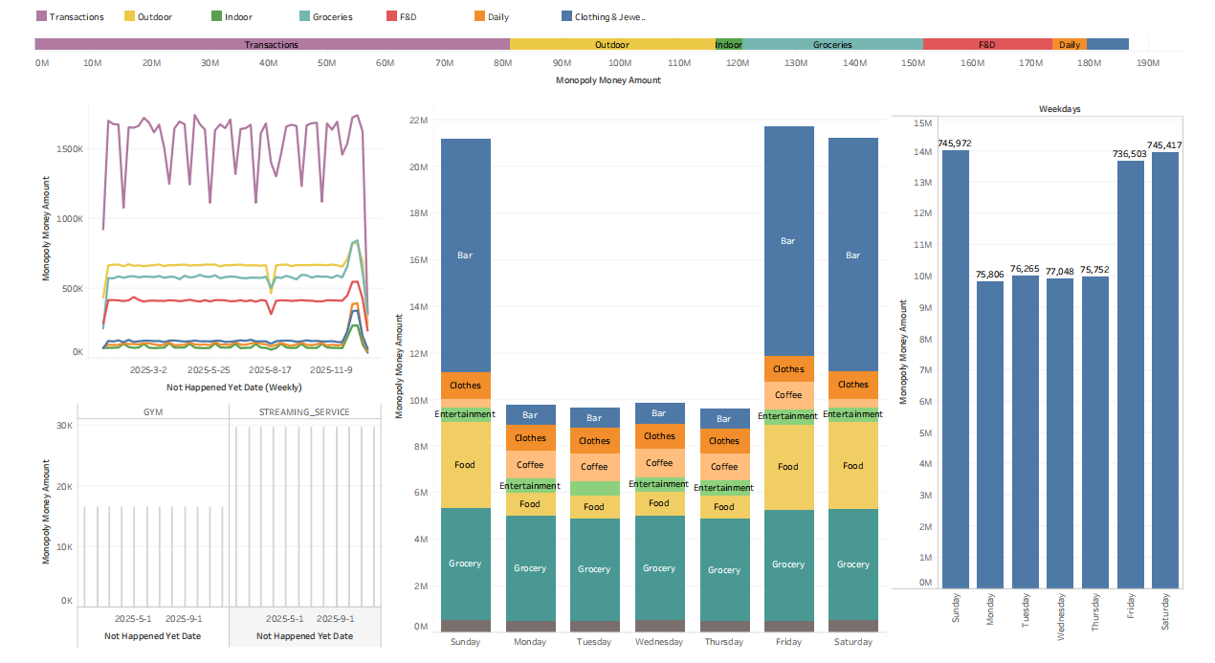
Annual Analysis
3

Slide 11
Background
Motivation
Annual Analysis
User Profiling
Data Source
Feature
Ethics
Annual Analysis
User Profiling
Purchase Trend
Time Persepecti-ve Service Design
Customer Types
New Feature
DIY Service Design
1
2
3
4

Slide 12
Customer Types
New Feature
DIY Service Design
User Profiling
4

Slide 13
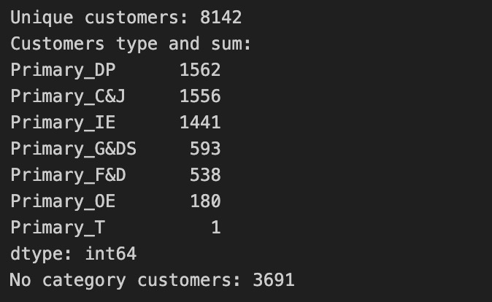
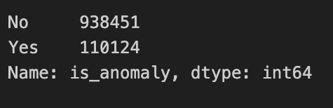
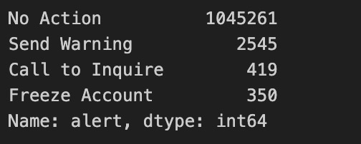
User Profiling
Customers Types
Outliers
Fraud Prediction
4

Slide 14

Future Plan

Slide 15

Any Questions?

Slide 16


